Slide 1


BIT MANIPULATION
{
< Competitive programming - Day 6 >
...
}

Slide 2
Contents
1. Bit manipulation approach
2. Example problem

Slide 3
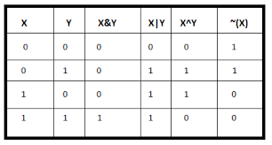
Bit Wise Operations
Bitwise AND, OR, XOR, NOT

Slide 4
Problem Statement
}
To count the number of set bits in the given integer.
*

Slide 5
Approach
{
..
Use a `while` loop that continues until `n` becomes zero. In each iteration of the loop, perform the following steps: Use a bitwise AND operation (`n & 1`) to check the rightmost bit of `n`. If it's 1, increment the `count` variable. Right-shift `n` by 1 position (`n >>= 1`) to move to the next bit.
}
..

Slide 6
Thank you for watching!
{
..
}
..

